Slide 1

Self-Monitoring Stress Device
Honors Team 14
Matthew Barondeau, Harini Cherupalla, Matthew Davis, Angelos Koulouras, Sneha Pendharkar, Neha Shah
Faculty Mentor: Dr. Emily Porter
The University of Texas at Austin
Notes:
Neha

Slide 2

Problem
Stress is a common feeling among college students (~63%)
Stress can impact long-term emotional and mental well-being
Our Goal
Make students more aware of their stress so they can handle it better
N. J. LeBlanc and L. Marques (2019, May 28). “Anxiety in college: What we know and how to cope” [Online]. Available: https://www.health.harvard.edu/
Notes:
Neha

Slide 3
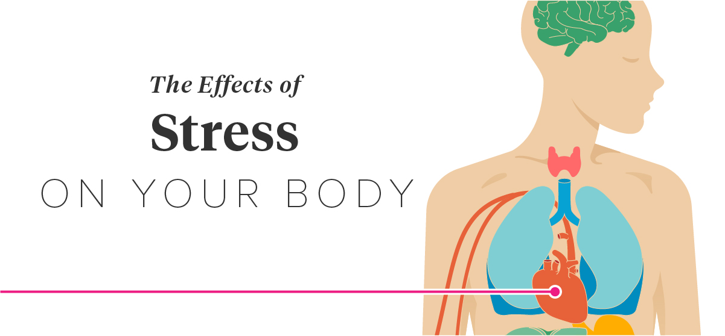

Elevated blood pressure
More sweat
Galvanic skin response
Increased heart rate
Pupil dilation
Changing body temperature
Notes:
Neha

Slide 4
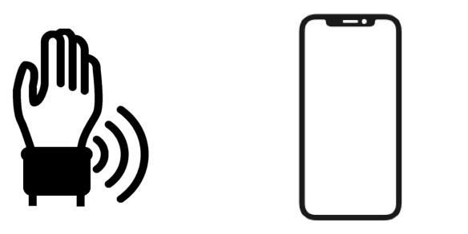
Wearable Device
Mobile Application
Our Design Solution
Hardware component - design our own network of sensors
Software component - develop an iOS application
Notes:
Neha

Slide 5
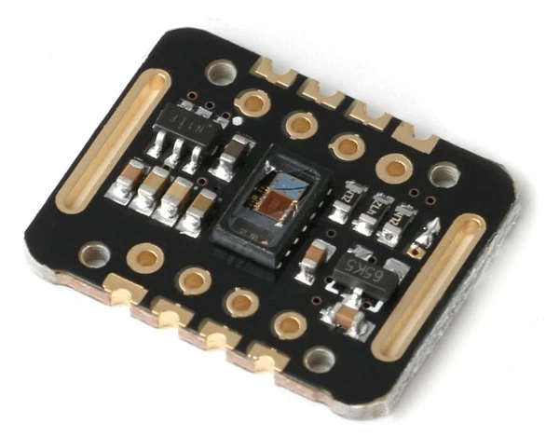
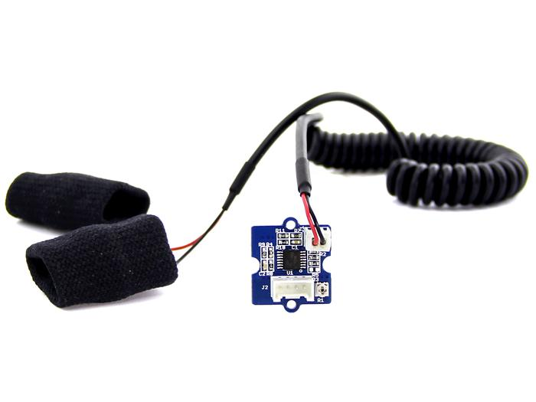
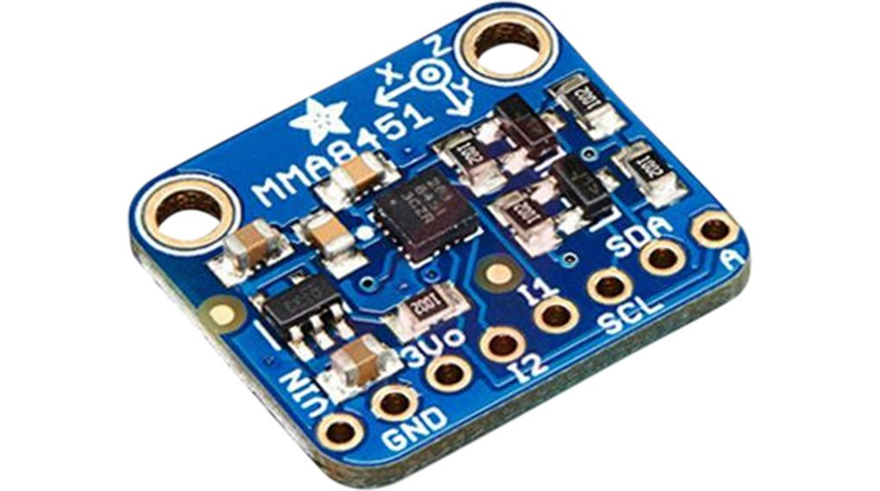
Hardware Sensors
MAX30102 Reflective Optical Sensor
(Heart Rate Sensor)
Grove GSR
(Skin Response Sensor)
MMA8451 Accelerometer
(Motion Sensor)
Notes:
Sneha

Slide 6
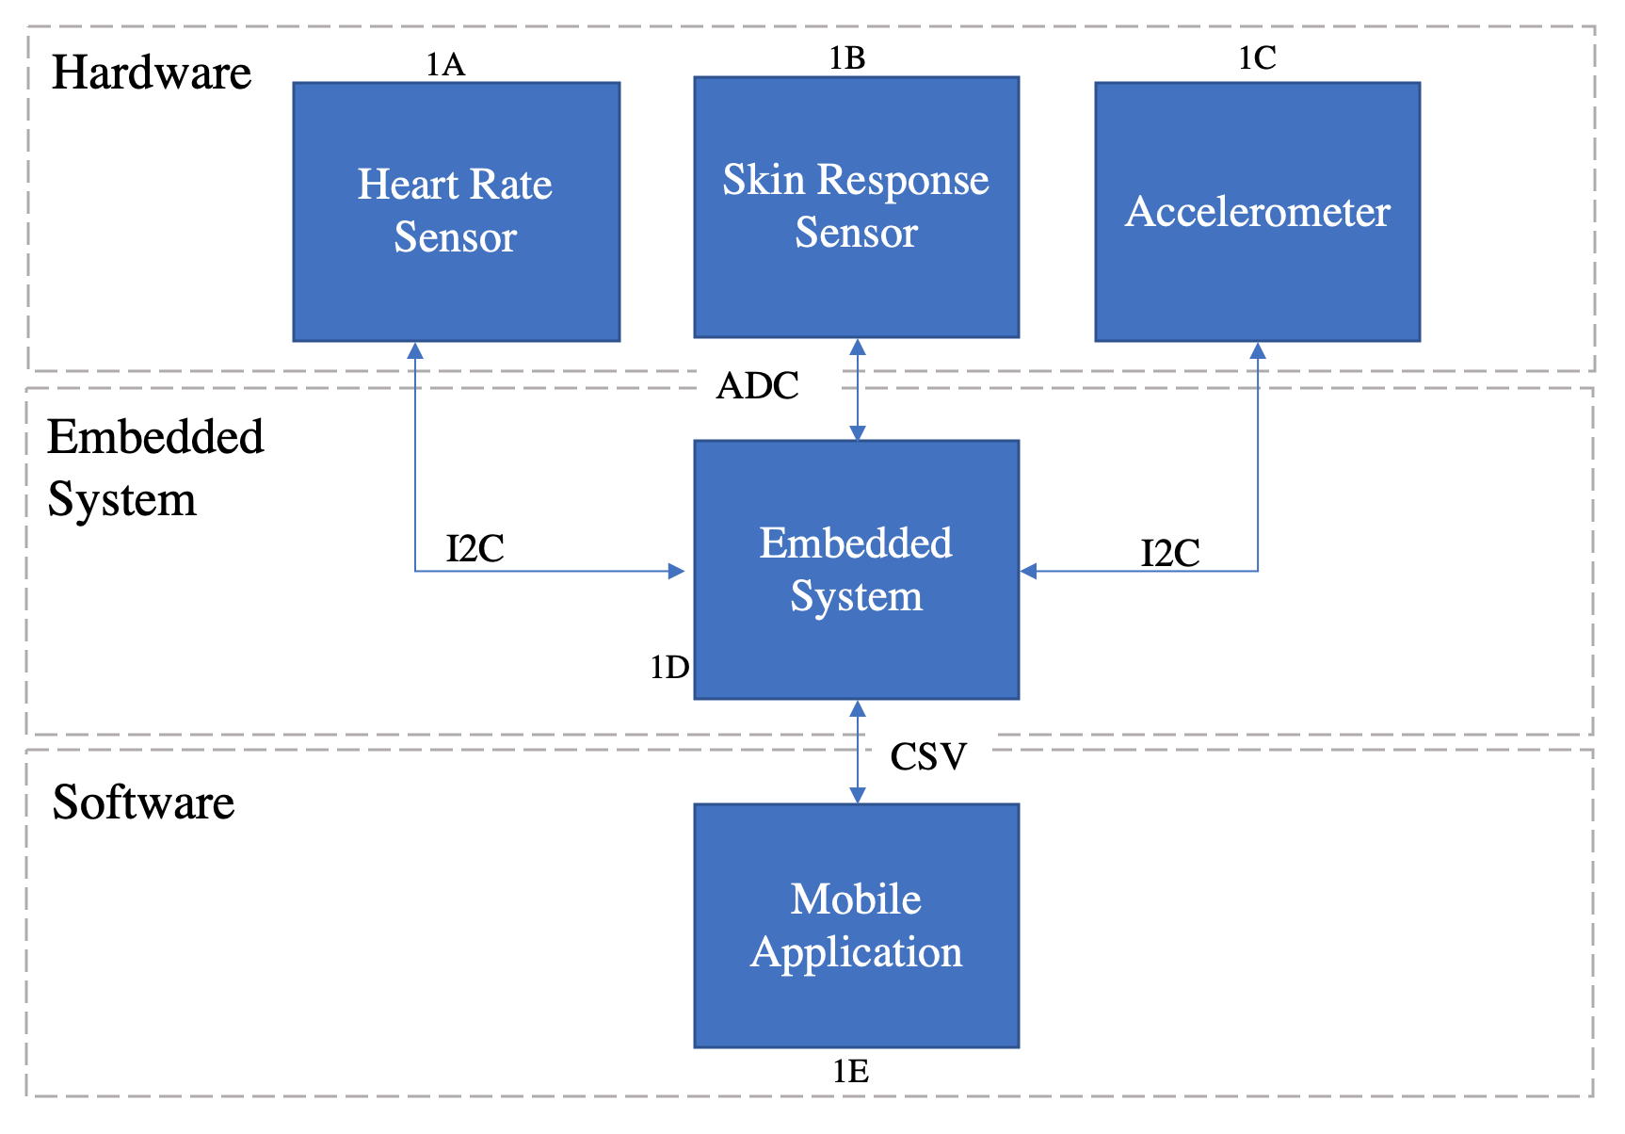
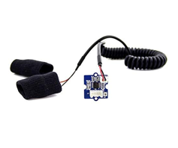
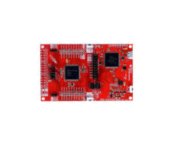
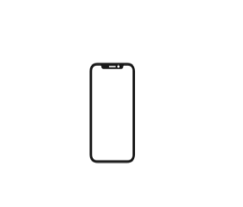
Heart rate sensor
Skin response sensor
Accelerometer
MSP432 Microcontroller
Mobile application
Notes:
Sneha

Slide 7
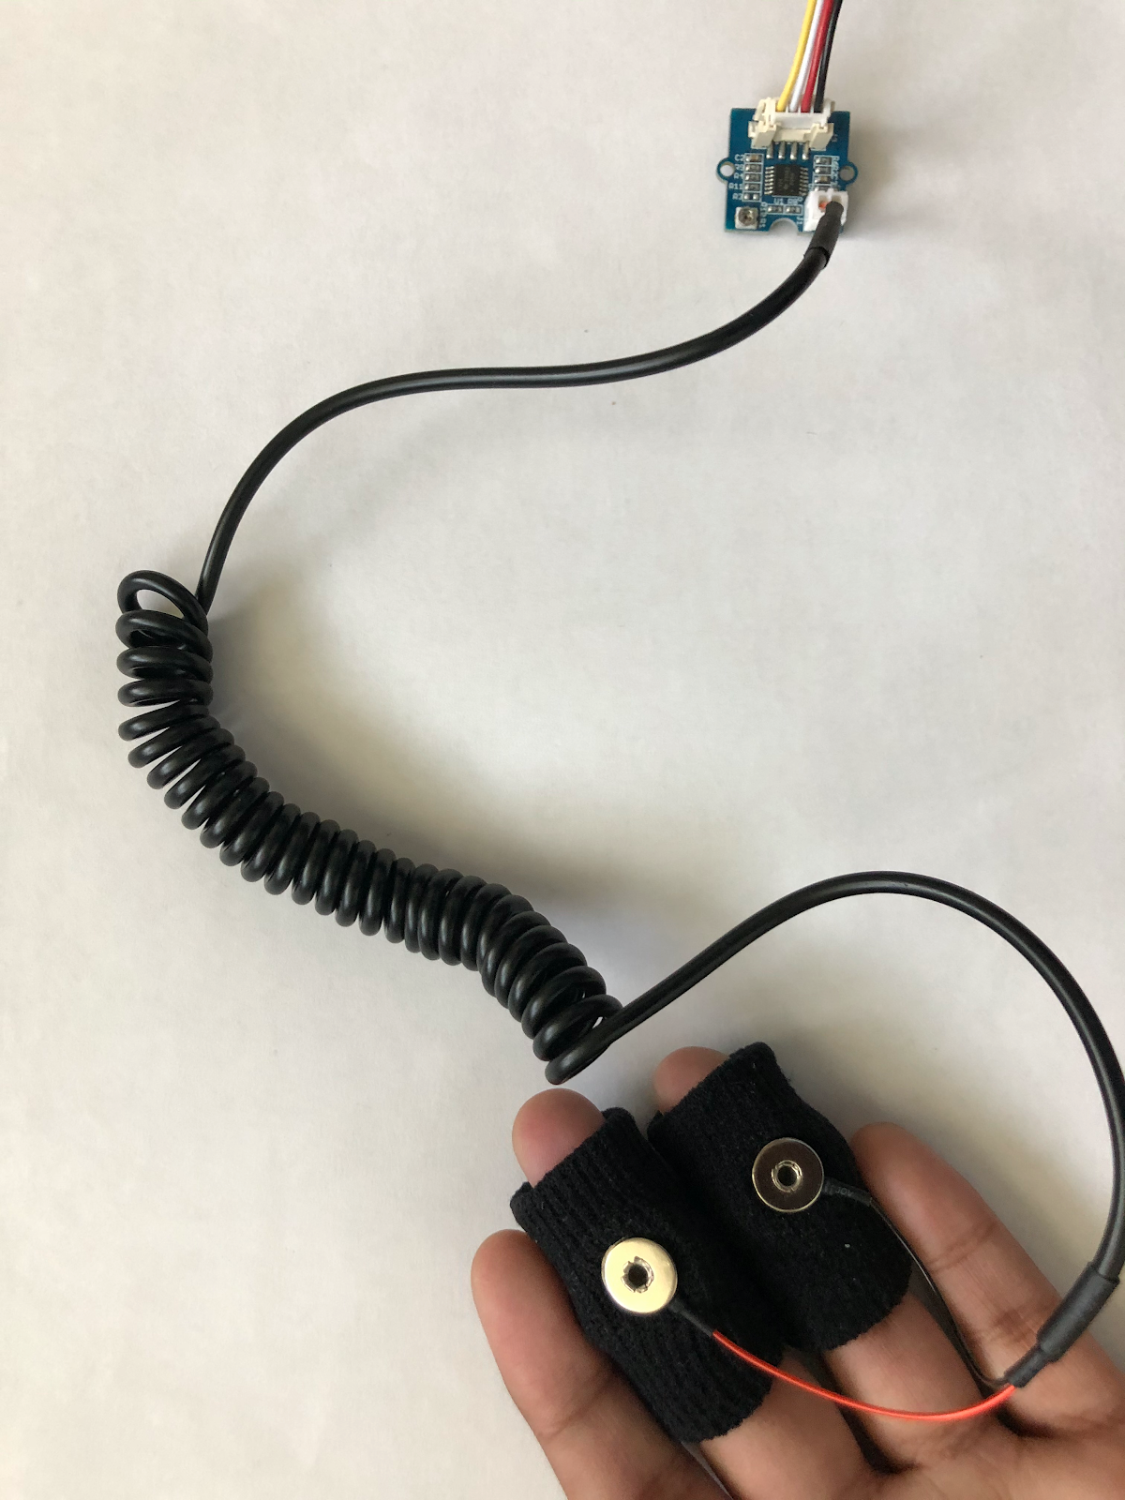
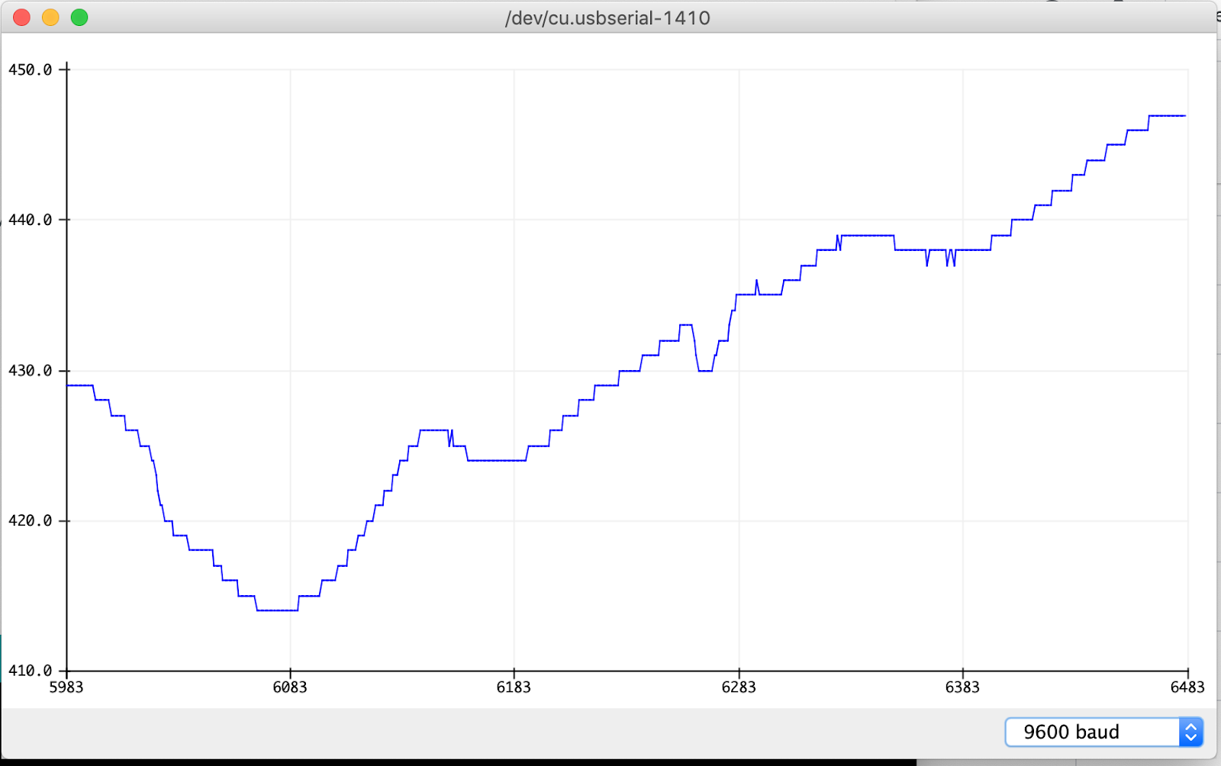
Test and Evaluation of GSR Sensor
Vary breathing (normal, deep, hold) and view the output of the sensor while breathing
GSR Output for Holding Breath
GSR
Notes:
Sneha

Slide 8
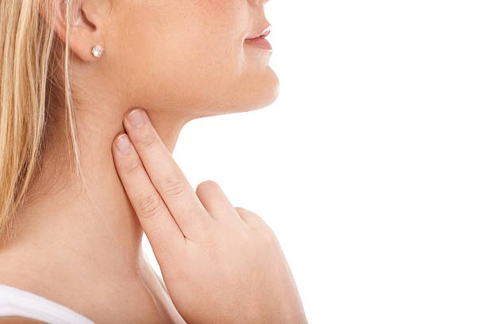
Test and Evaluation of Reflective Optical Sensor
Compared sensor readings with manual heart rate measurement from carotid artery,
10 trials, 95% accuracy
ROS
Notes:
Sneha

Slide 9
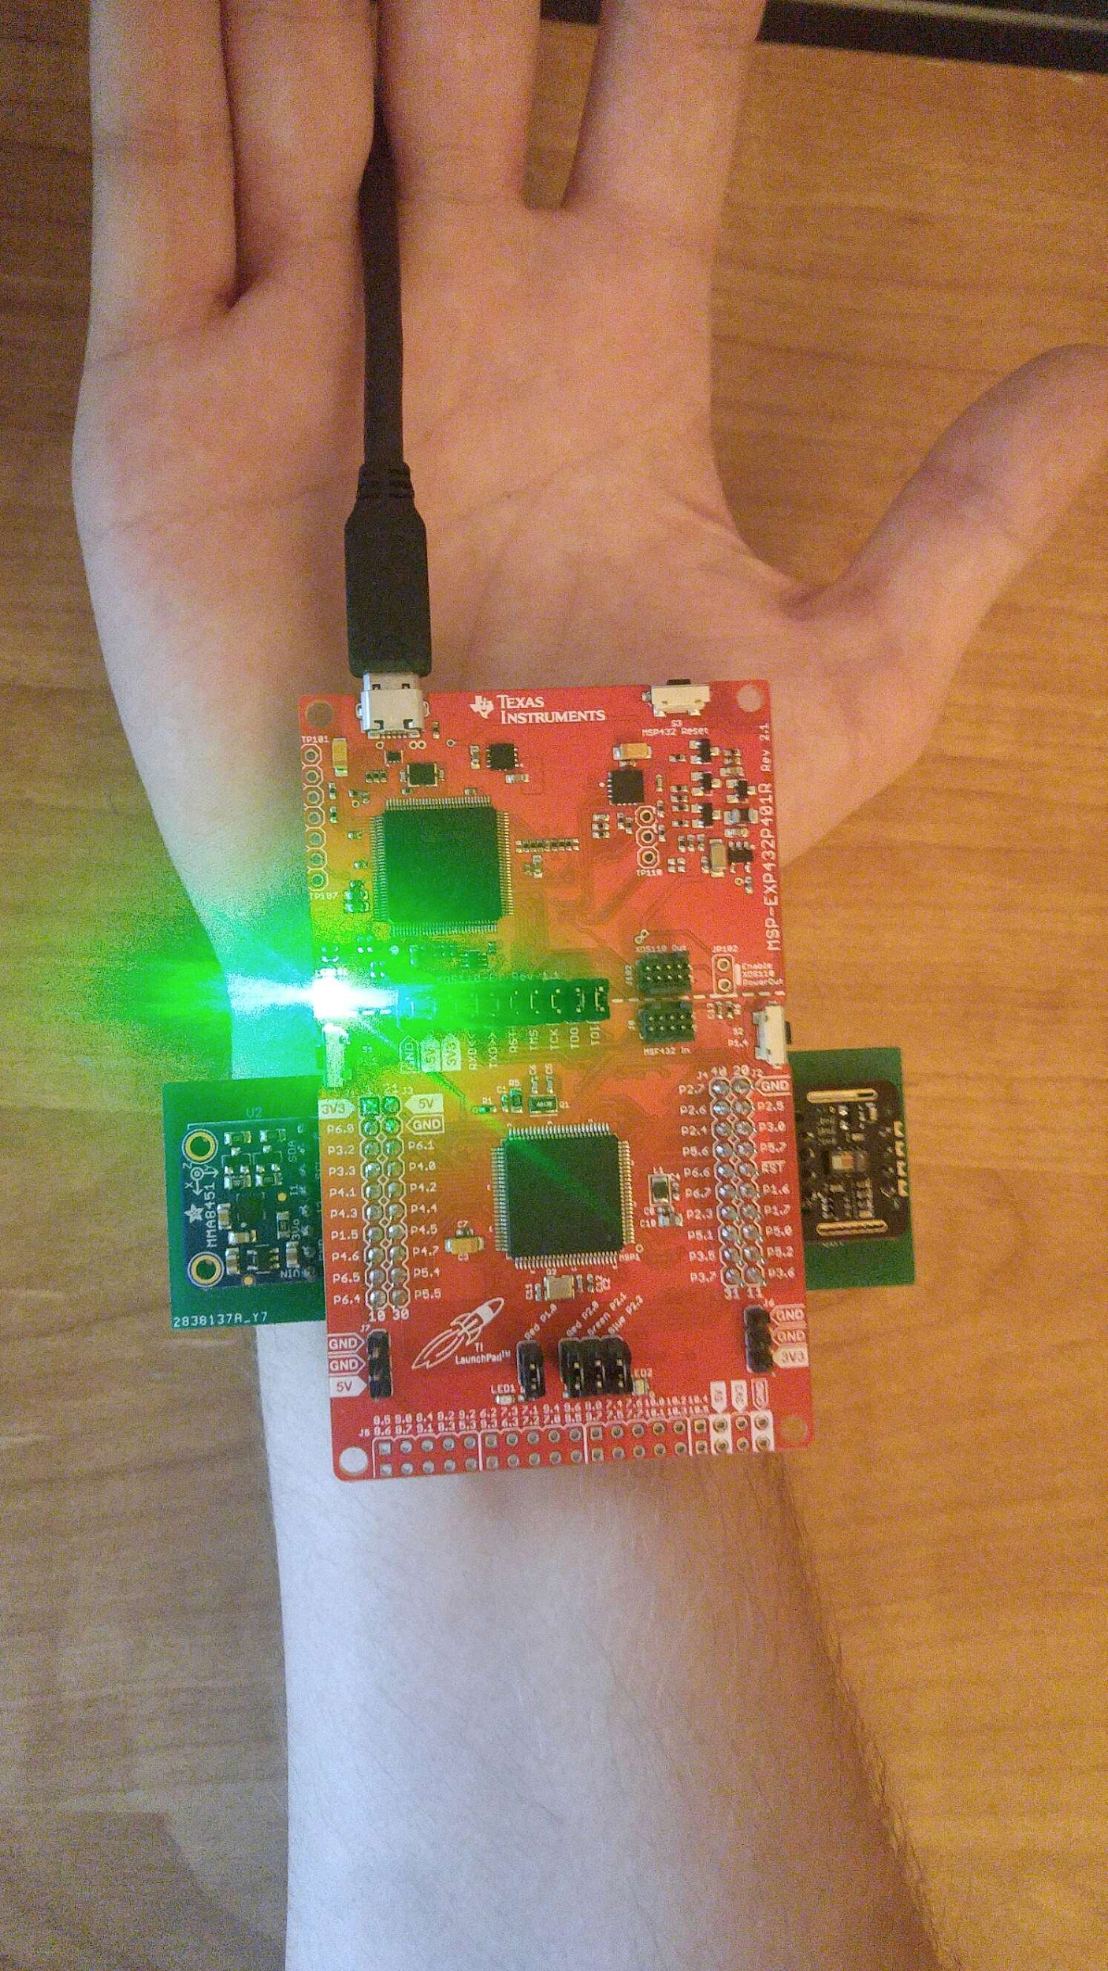
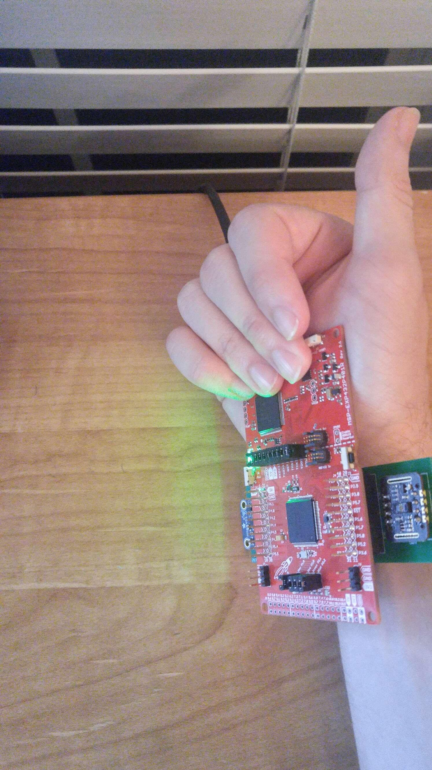
Test and Evaluation of Accelerometer
Viewed sensor readings while sensor is moved in different directions
Accelerometer
Notes:
Sneha

Slide 10
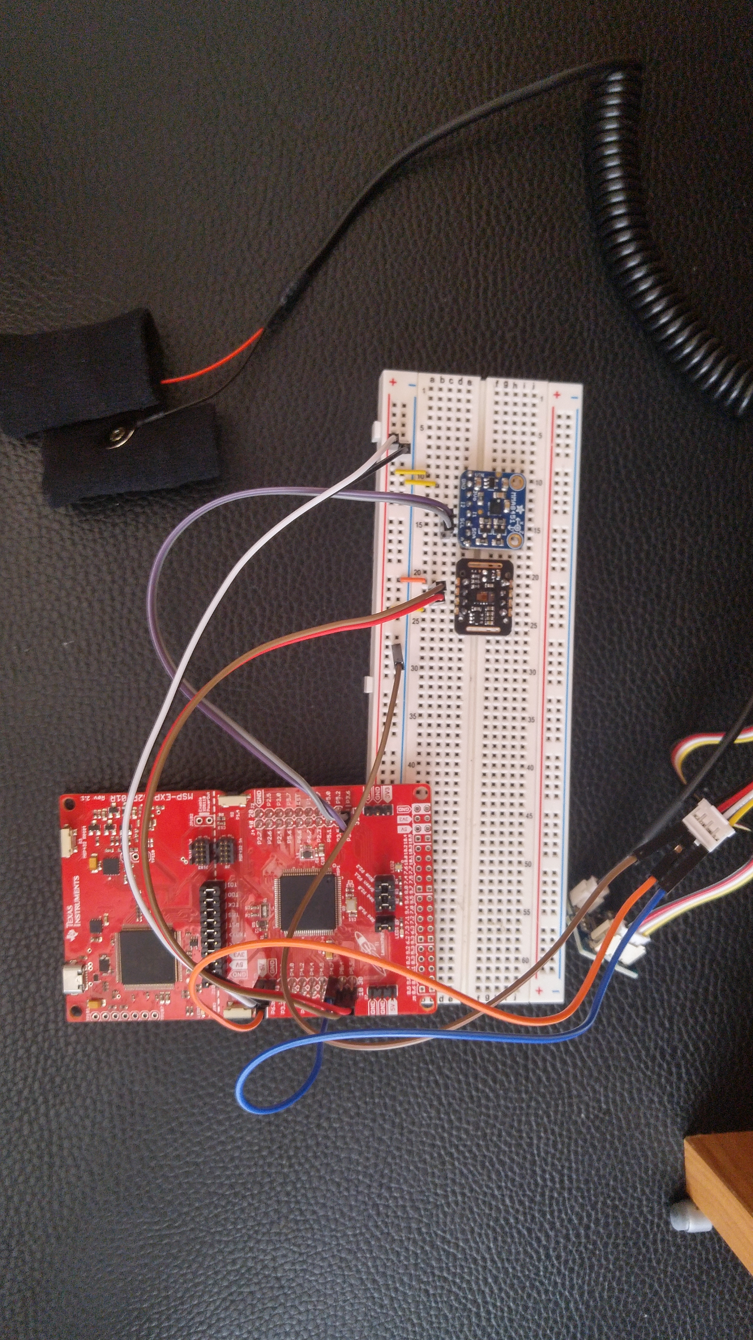
System V1
MSP432 Launchpad connected to breadboard circuit
I2C Interface for MMA8451 and MAX30102
Analog Voltage Interface for GSR
Notes:
Matthew
Breadboard version
GSR just returned a voltage so it worked fine
Had to write the stupid repeated start drivers
ROS and ACC crashed after about a minute
Excess Capacitance on breadboard was causing a problem -> Designed a PCB v1

Slide 11
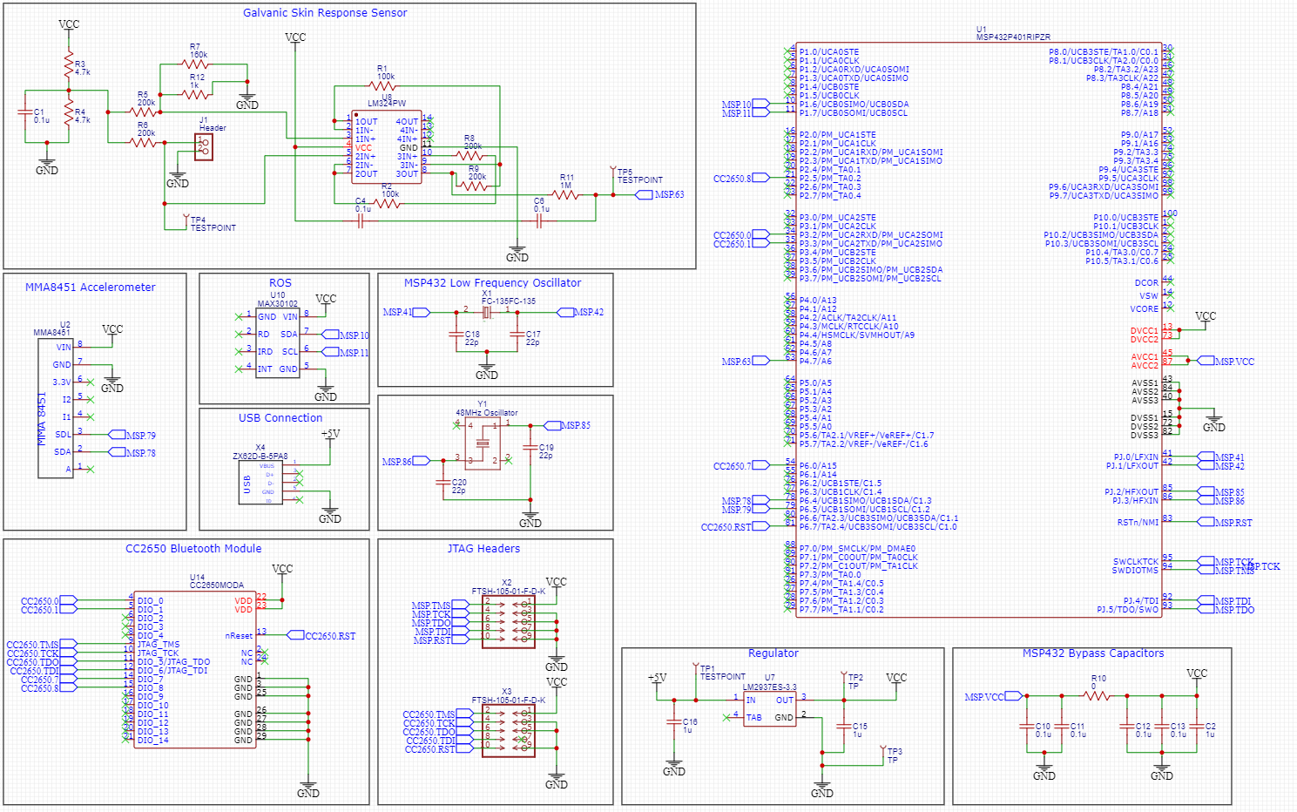
Schematic
Notes:
Matthew
Laid out GSR
Designed Power interface
Ordered mid to late january

Slide 12
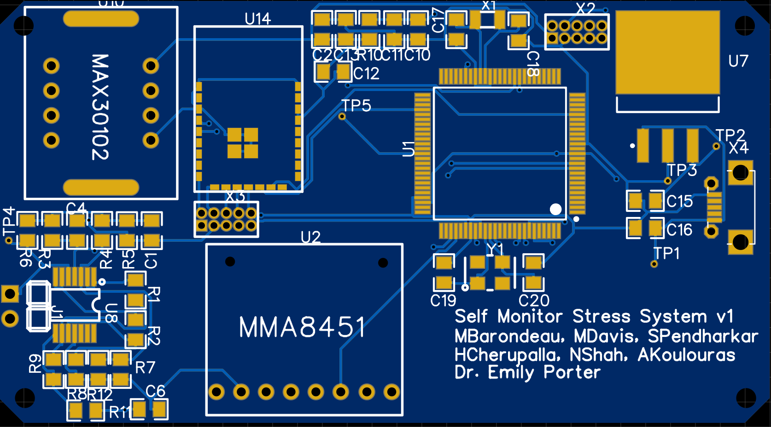
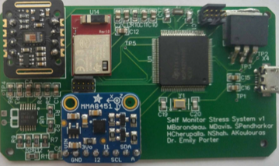
System V2
MSP432 Chip
Laid out GSR sensor in bottom left
Other sensors placed directly on PCB
Reflow oven required
Notes:
Matthew
Awesome guy, but really small
Small board led to some interesting pin configurations for some components
Pins directly underneat U14 -> Reflow Oven -> How reflow worked
Lost Access to undergraduate labs meant that we couldn’t finish board -> Board V2

Slide 13
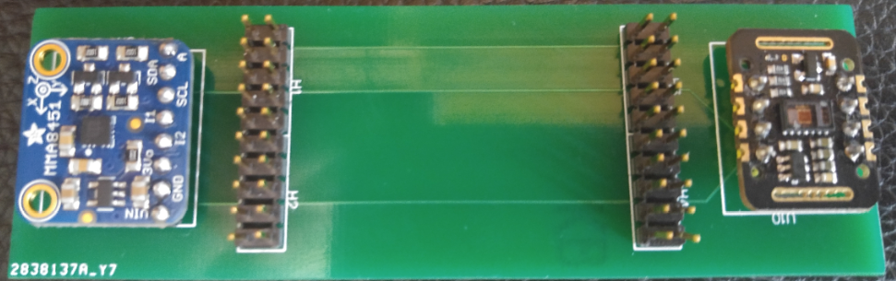
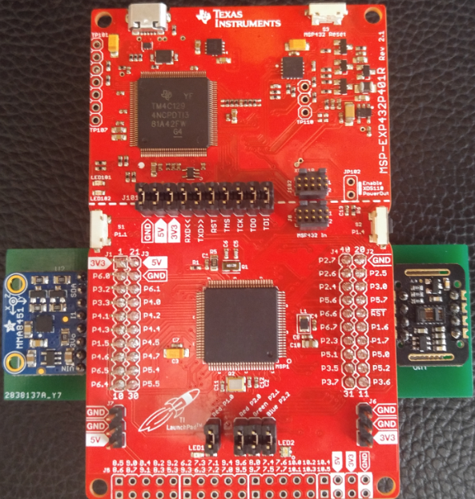
System V3
PCB Boosterpack for MSP432
I2C connection unreliable on breadboard
Still used jumper wire interface for GSR
Notes:
Matthew
Uses TI Boosterpack approach where headers directly connect launchpad to sensors
Made data connection reliable
GSR still connected through wires
Unfortunately doesn’t really fit on the wrist anymore
But, we were able to get all the sensor values to train our model

Slide 14
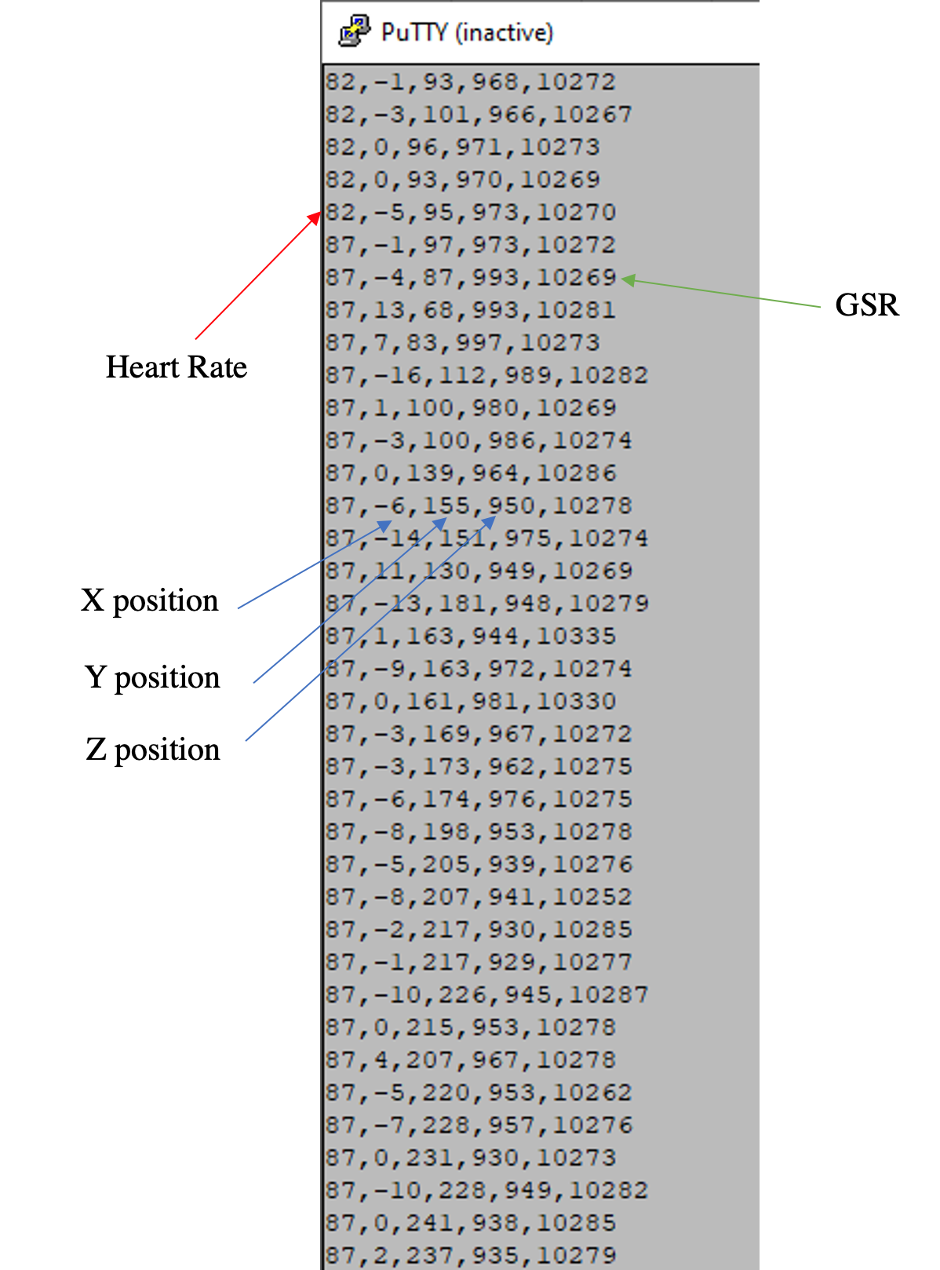
Transmitting Sensor Data
(Serial Console)
Notes:
Matthew
So heres what the data looks like
HR, X, Y, Z, GSR
In this example, I start moving around, my heart rate increases, Y position changes so we would mark the next swatch of data as unreliable

Slide 15
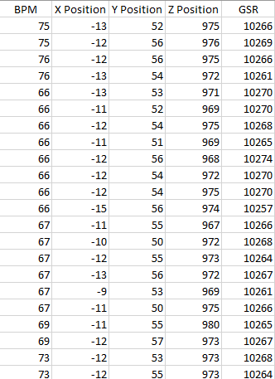
Transmitting Sensor Data
(CSV)
Notes:
Matthew
Clean data collection: Sitting down in a chair, X, Y, Z values are stable, GSR cyclical

Slide 16
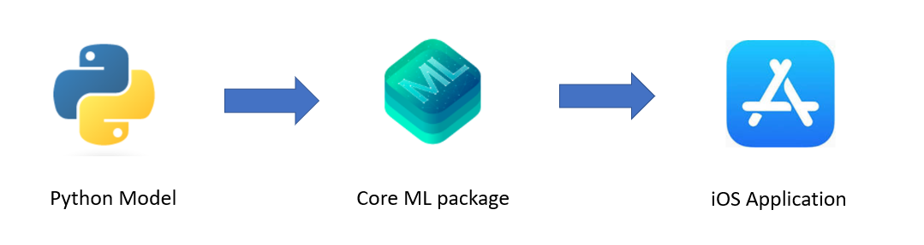
Classifying Data on the Mobile Application
Why:
Personalization
Accuracy
How:
Apple Core ML
App Models:
kNN classifier
Neural Net (Keras)
Data:
Existing stress dataset
Notes:
Angelos
Each person’s heart rate and GSR values are different when they are stressed and not stressed

Slide 17
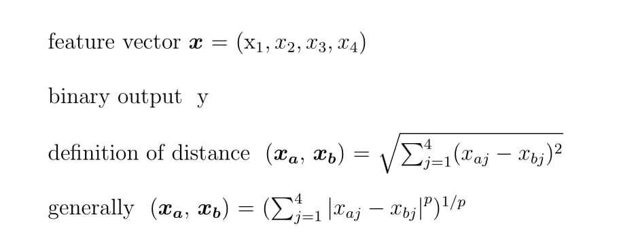
Model Details
Method
Find k closest points to the current one
Predict the label using the mean of the y-values of those closest points
Notes:
Angelos

Slide 18
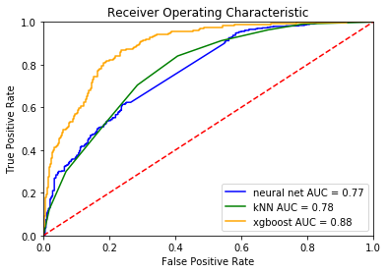
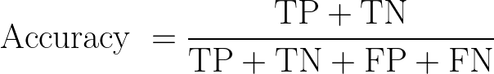
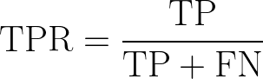
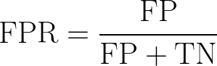

Model Performance
Terms: True Positive (TP), True Negative (TN), False Positive (FP), False Negative (FN), True Positive Rate (TPR), False Positive Rate (FPR)

Slide 19
Model Performance
Model | Accuracy | AUC
kNN (k=8) | 0.71 | 0.78
Logistic Regression | 0.62 | 0.70
Decision Tree | 0.76 | 0.83
Random Forest | 0.79 | 0.87
XGBoost | 0.82 | 0.88
Neural Net (Keras) | 0.69 | 0.77
Notes:
Angelos

Slide 20
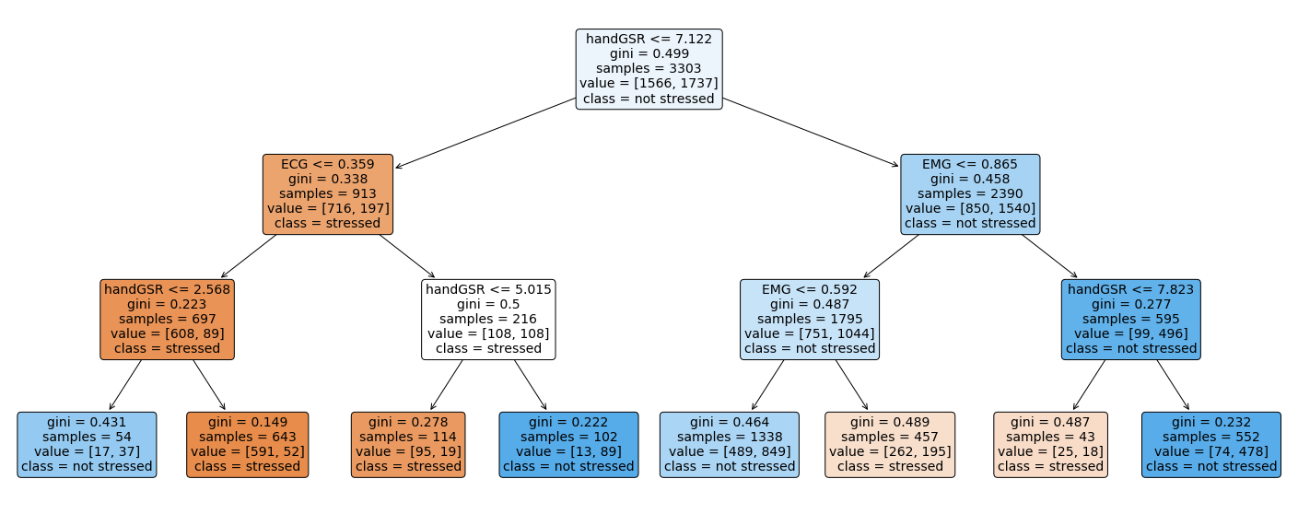
Depth 3 Decision Tree for Explainability
Accuracy: 0.71
AUC: 0.76
Notes:
Angelos

Slide 21
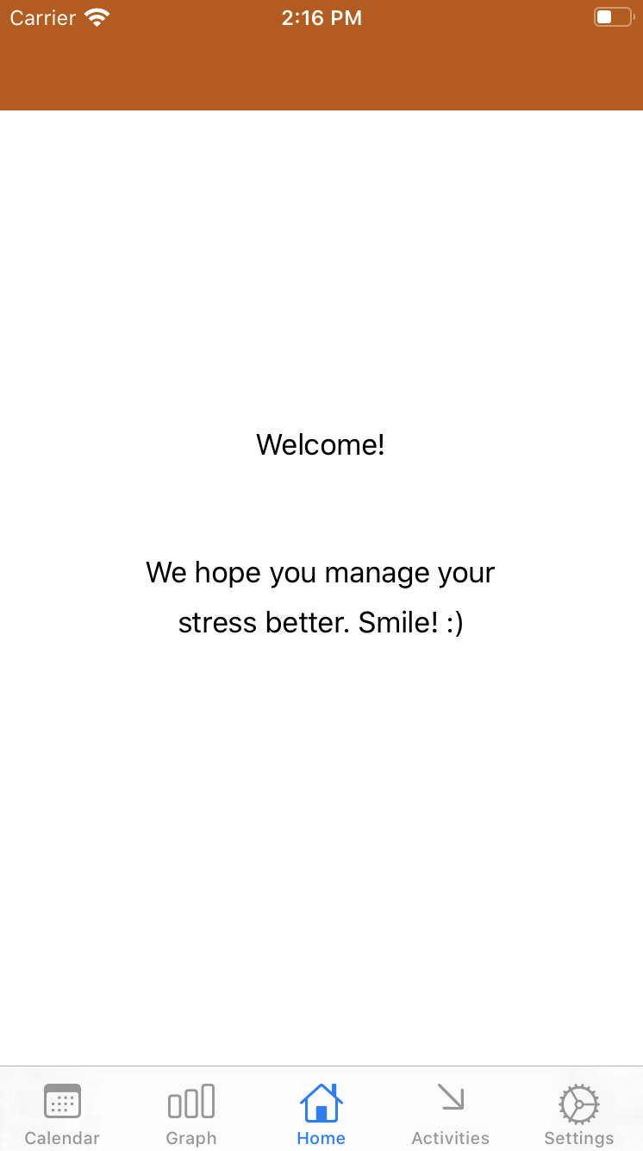
iOS Application: Porterable
Integrated with hardware for seamless experience
Provides accessible data visualization
Homescreen
Went with a low stress home screen for the most comfortable experience possible
Notes:
Matt

Slide 22
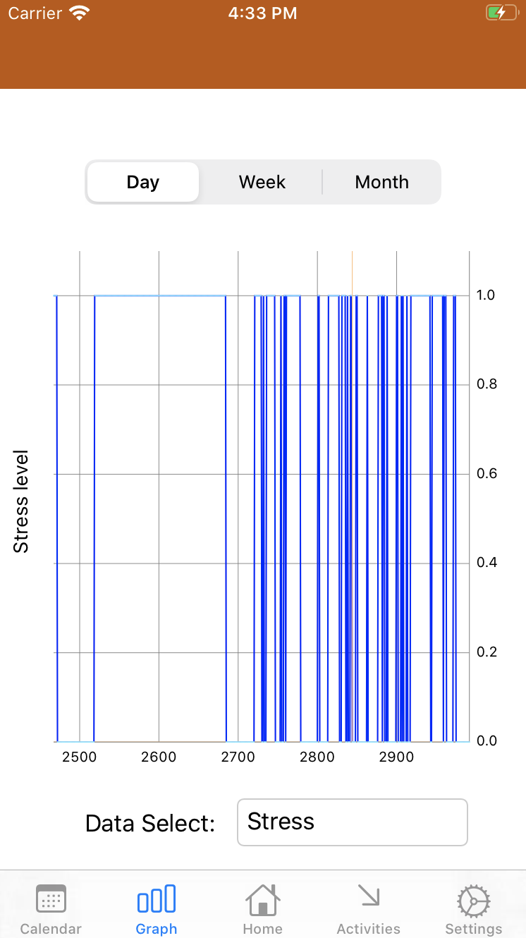
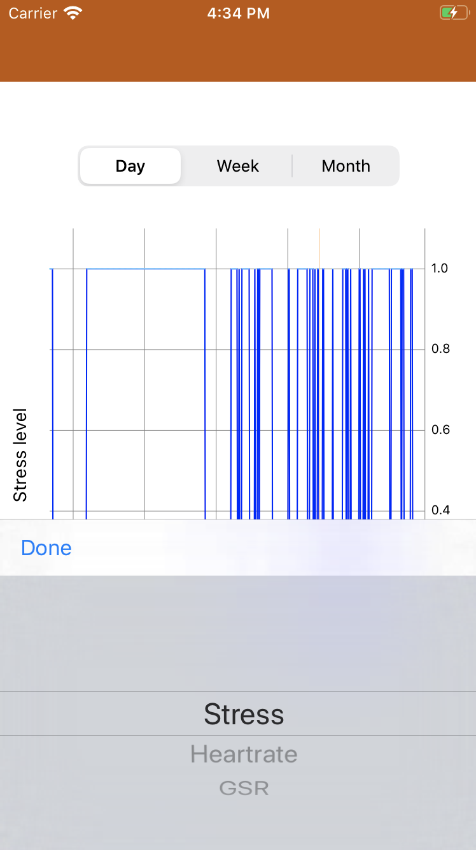
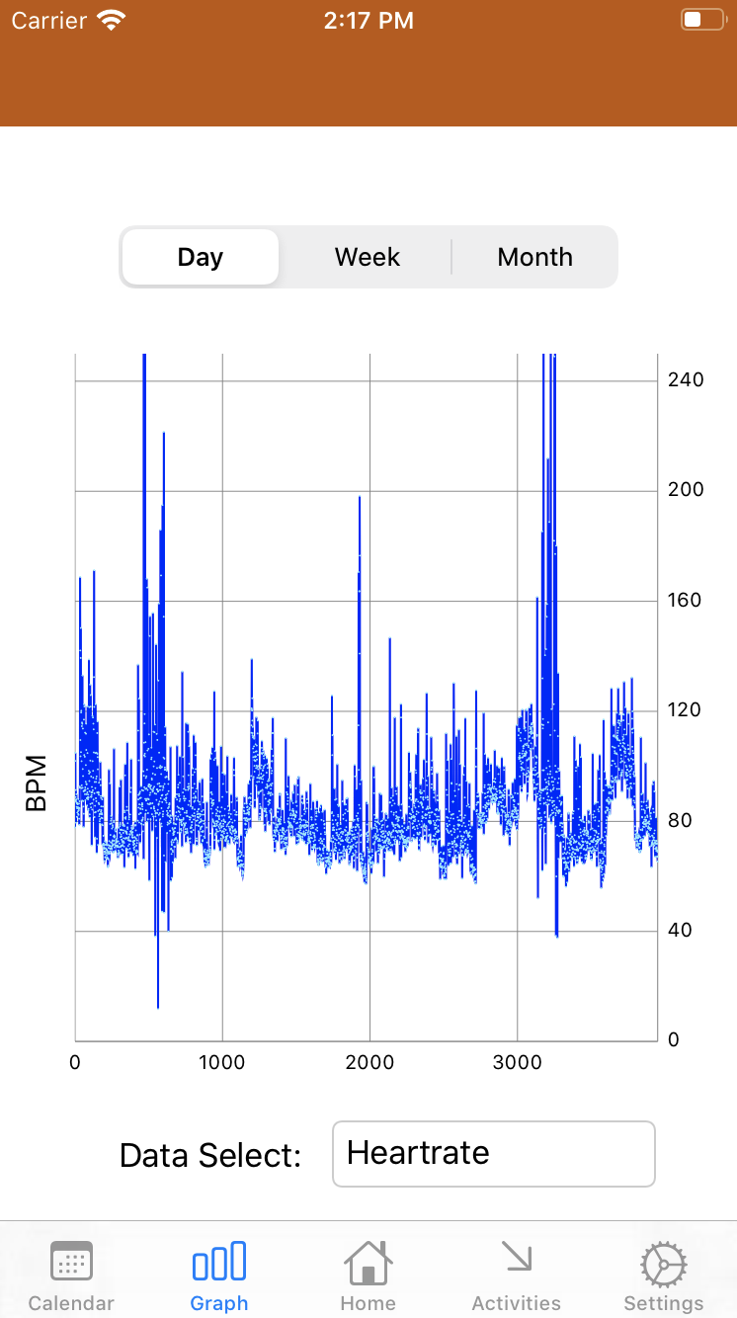
Graph Visualization
Line graph for easy readability
Allows user to access different data from hardware along with stress levels
Filtering options for time periods
Notes:
Matt

Slide 23
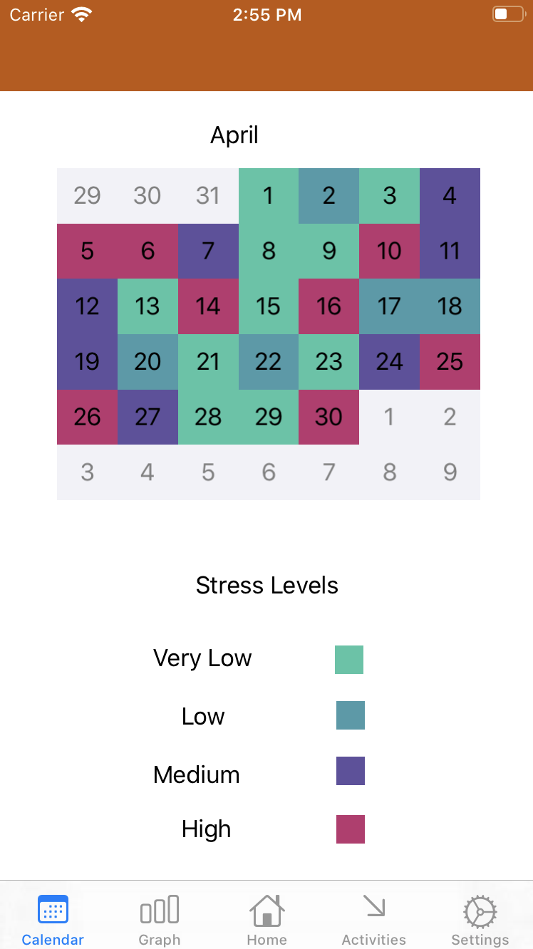
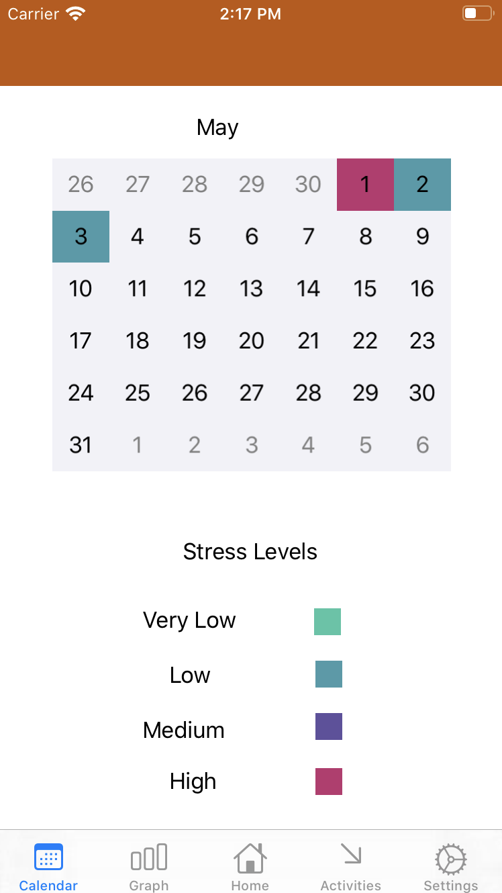
Calendar View
More human friendly way of visualizing recent stress
Notes:
Matt

Slide 24
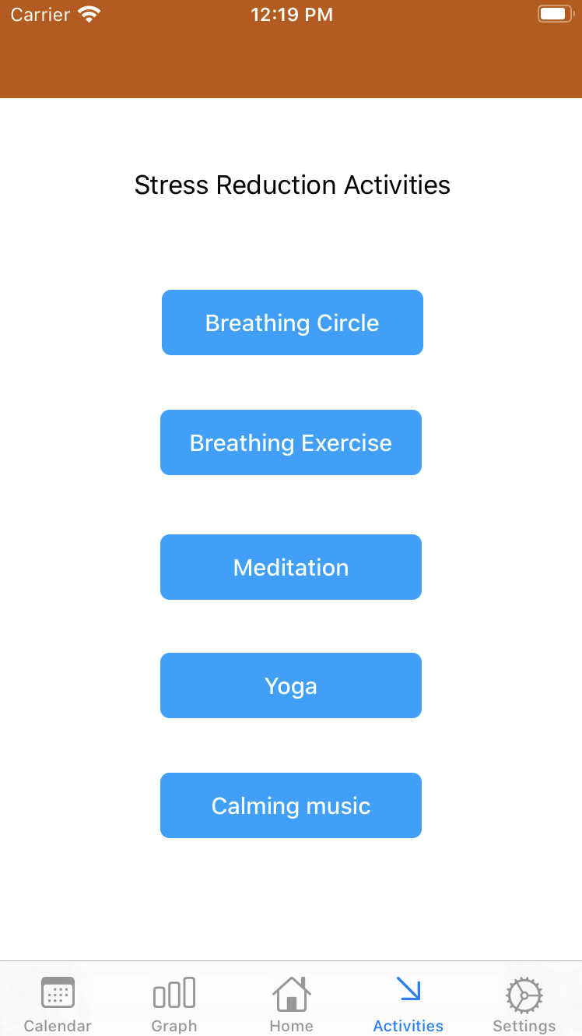
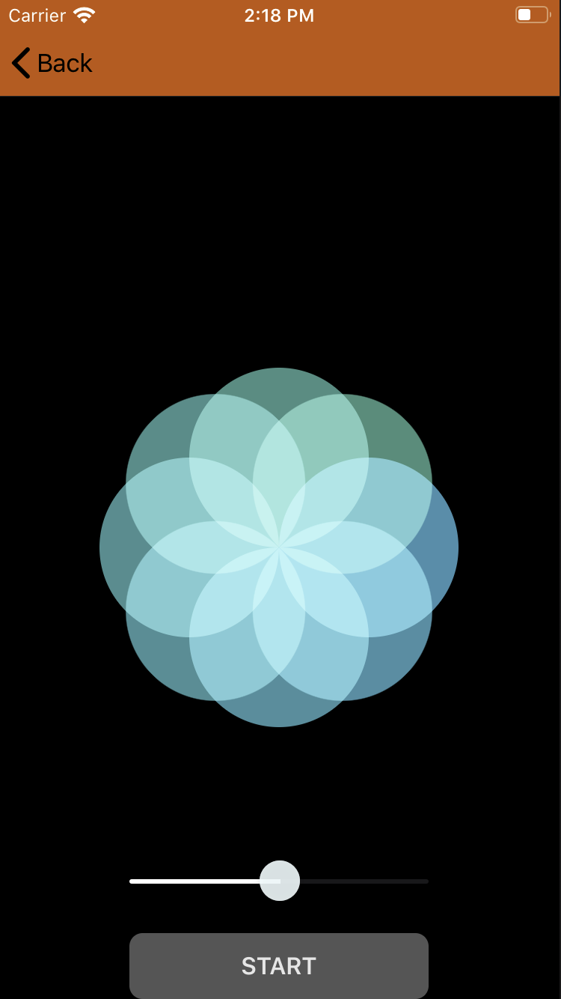
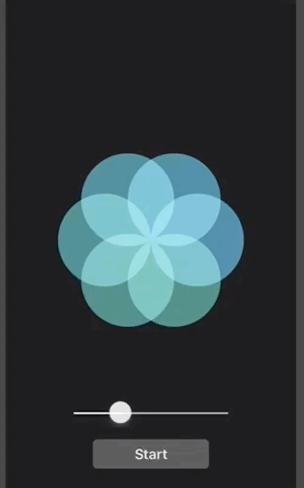
Activities Tab
Integrated breathing exercise
Links to other stress reducing activities
Notes:
Matt

Slide 25
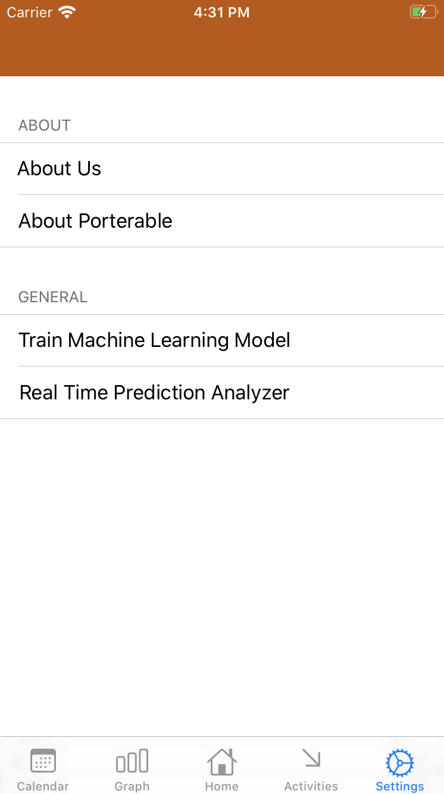
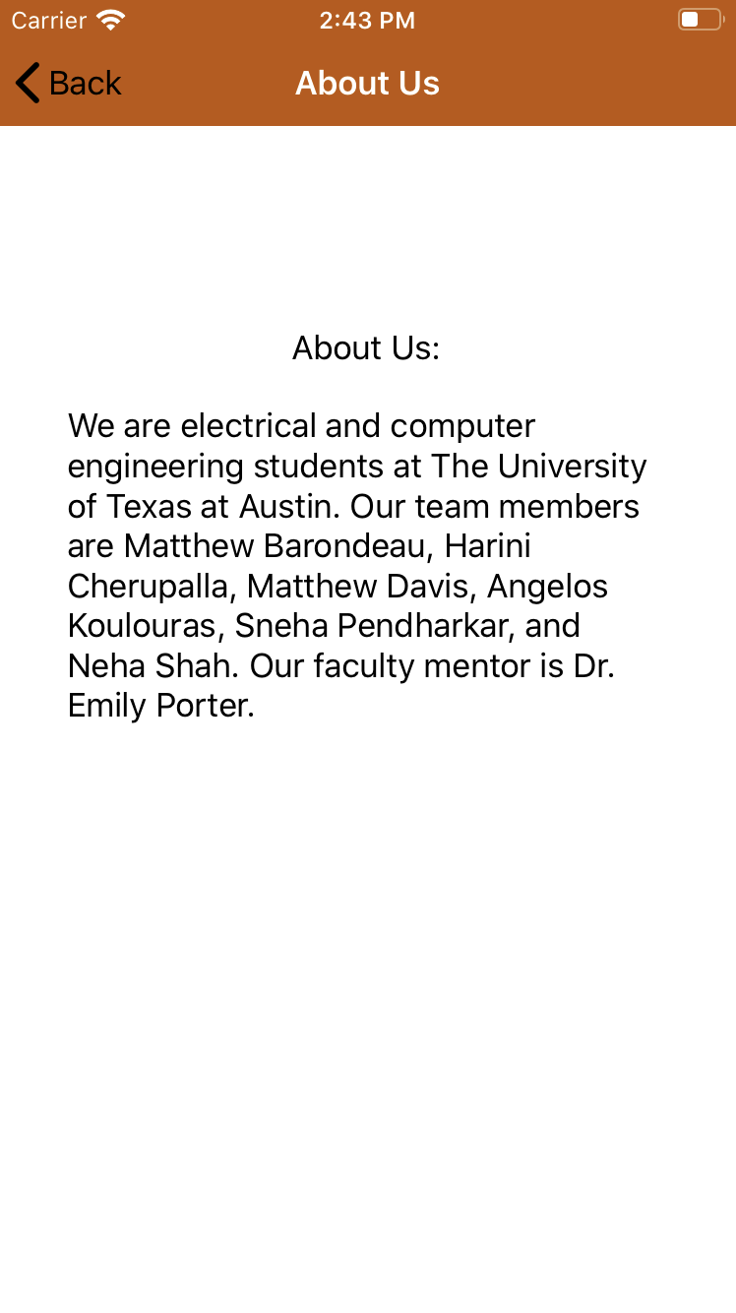
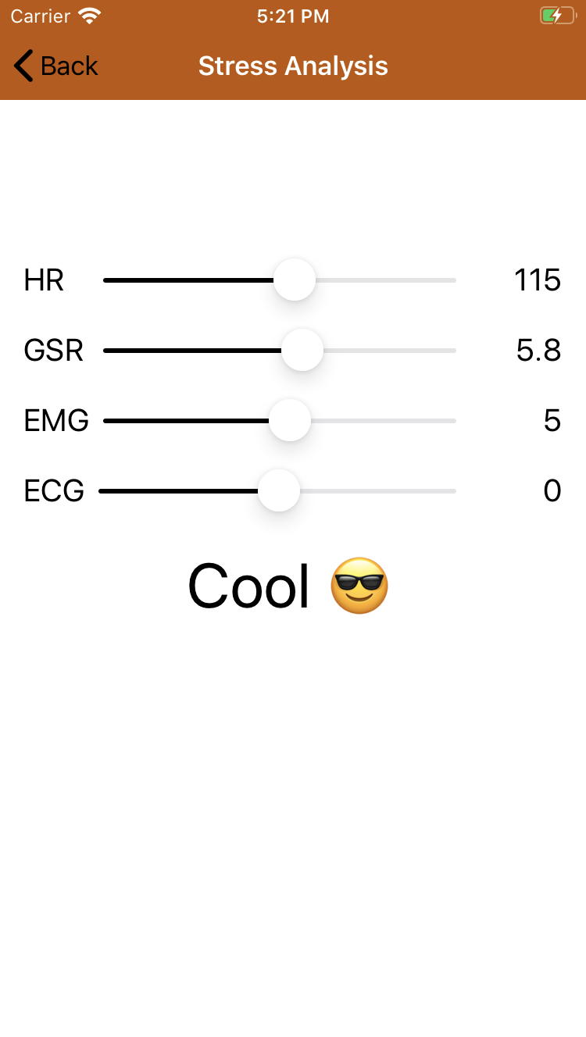
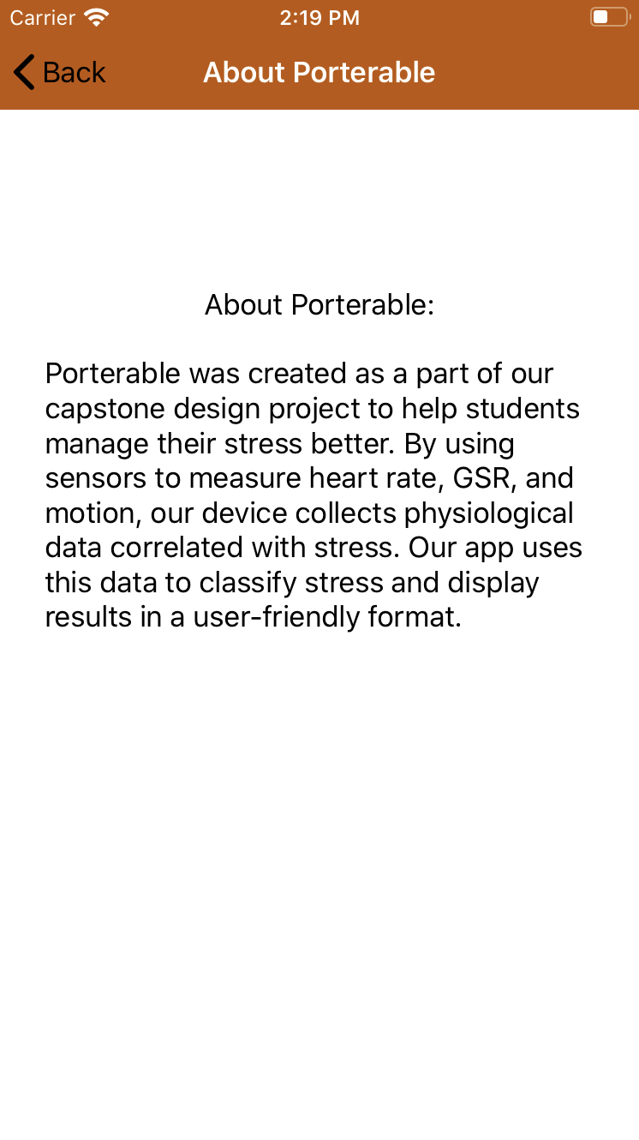
Settings Page
Blurbs to find out more about the team and the project
A button to train the machine learning model, and analyze its output from given inputs
Notes:
Matt

Slide 26
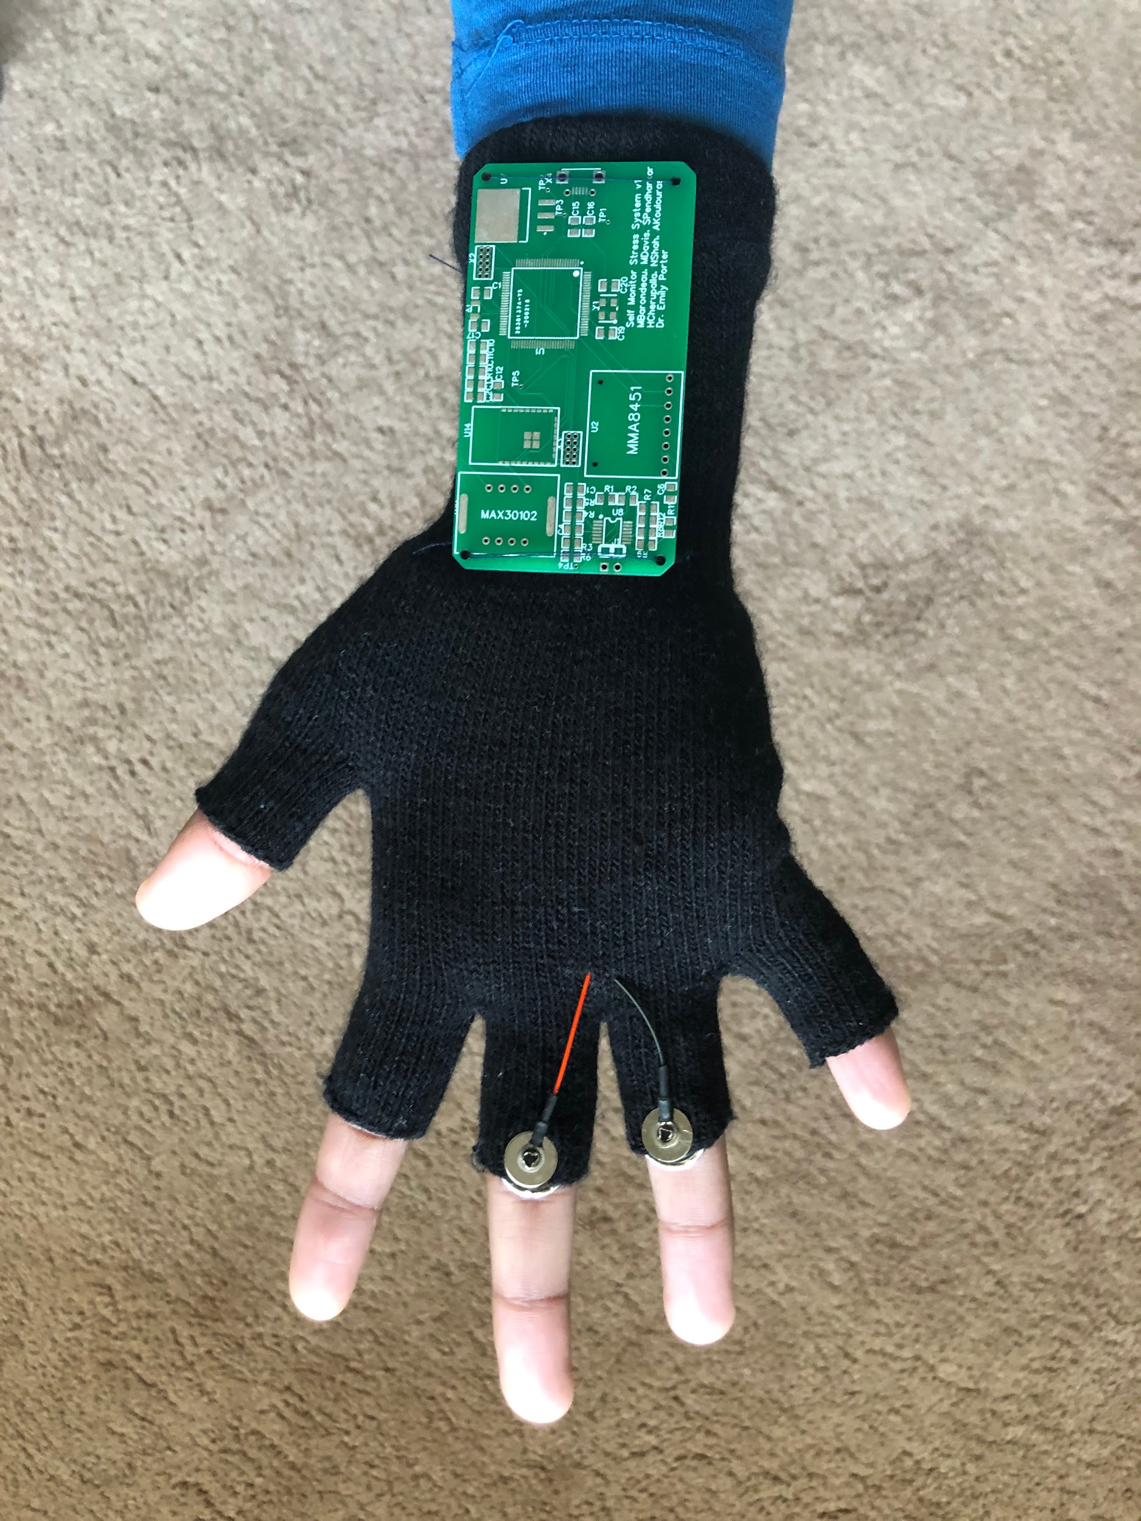
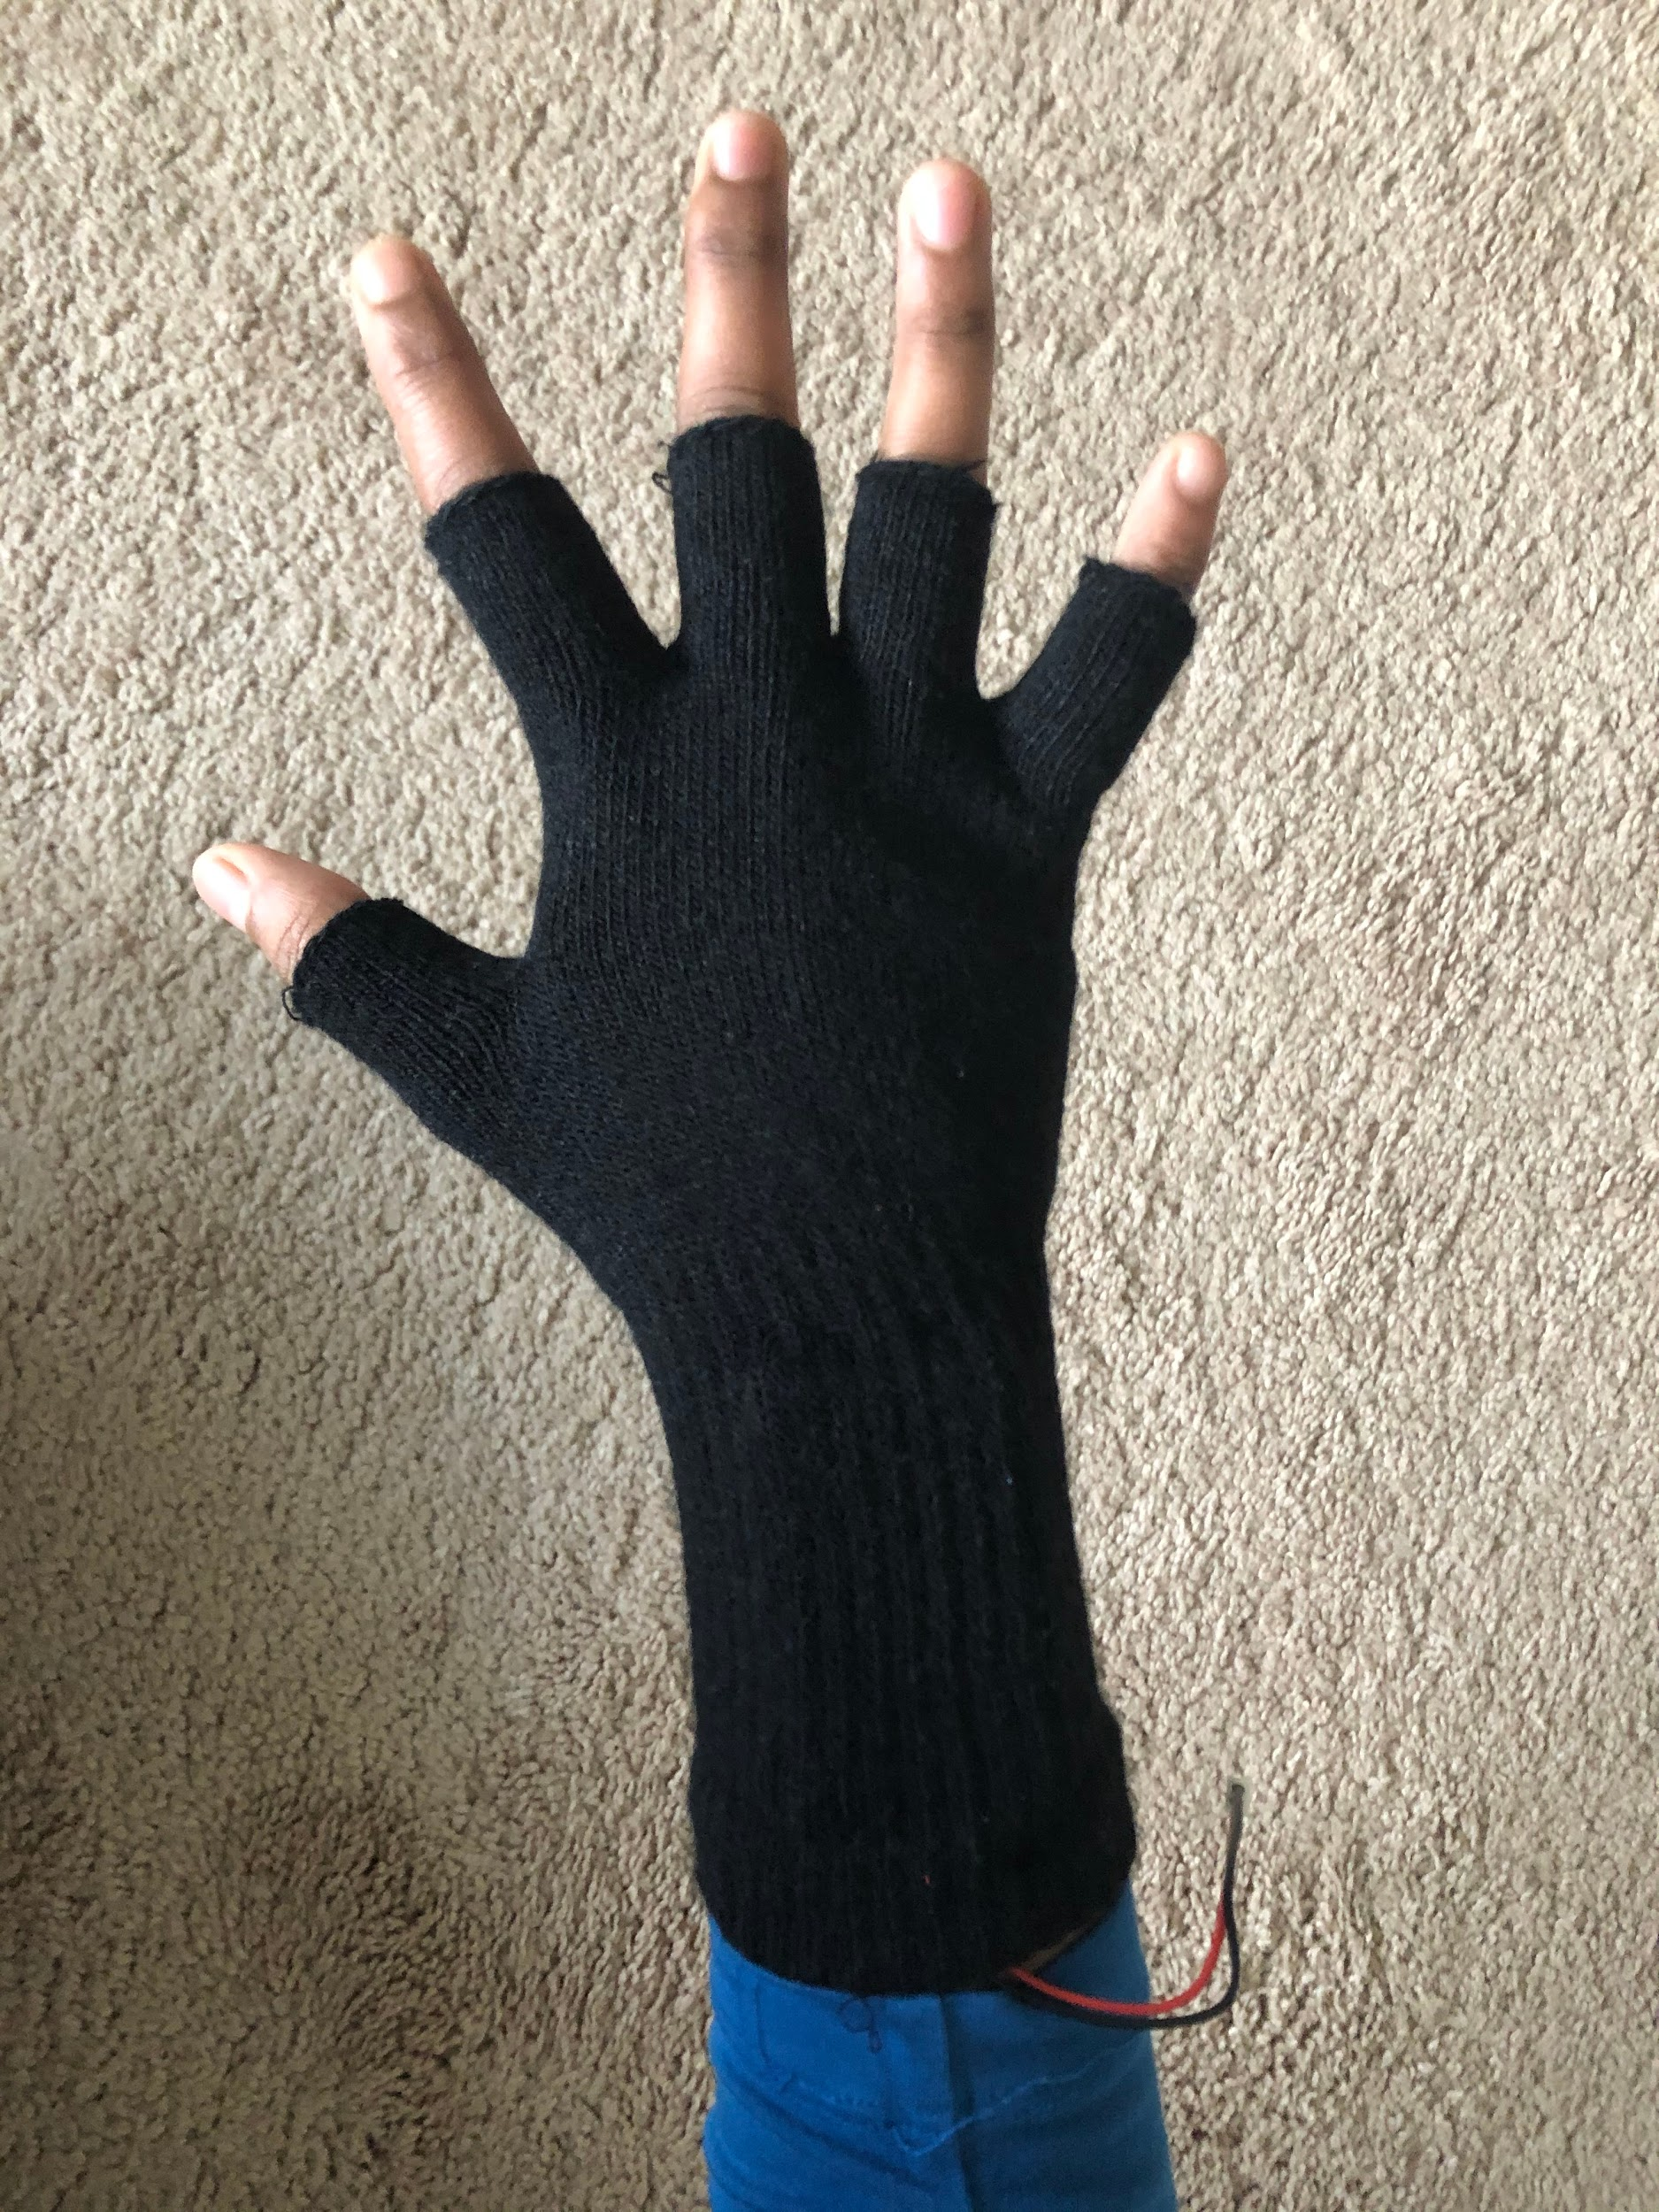
Front of Glove
Back of Glove
Notes:
Harini

Slide 27
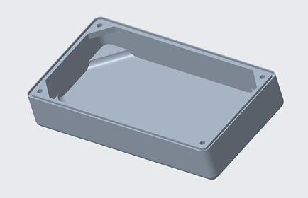
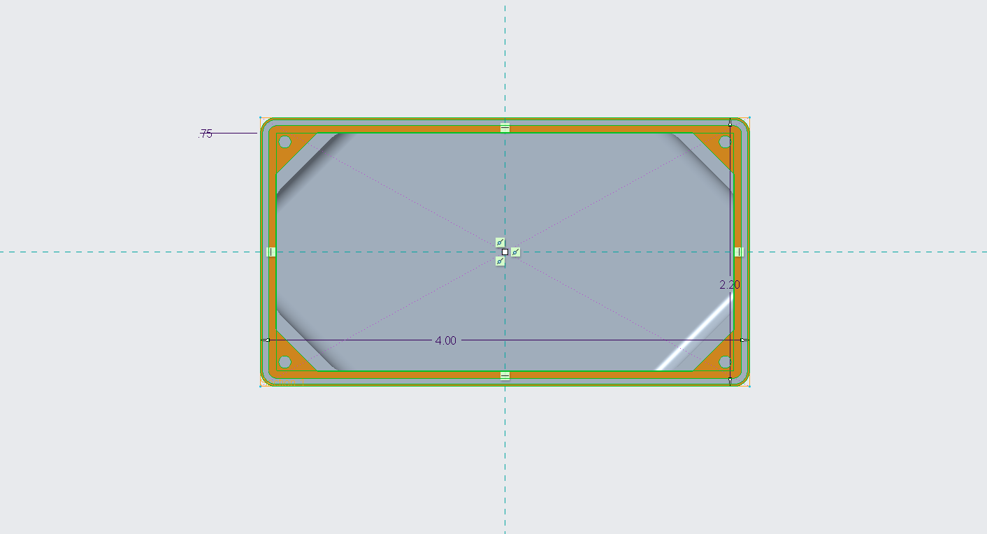
3D Printed Case
Notes:
Harini

Slide 28
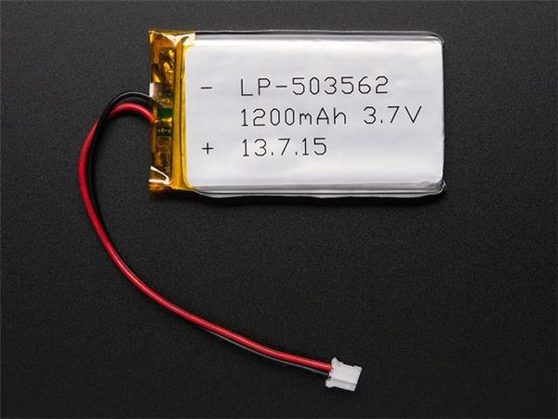
Rechargeable Battery
Notes:
Harini

Slide 29



Future Recommendations
Notes:
Harini

Slide 30
Key Takeaways
Built network of sensors
Created model that can be retrained for personal use
Designed iOS app
Functioning proof-of-concept
*Need to improve accuracy + portability for future use
Notes:
Harini

Slide 31
Thank You!
Faculty Mentor: Dr. Emily Porter
Technical TA: Abhishek Kumar
Writing TA: Oliver Davidson
Notes:
Harini

